Slide 1
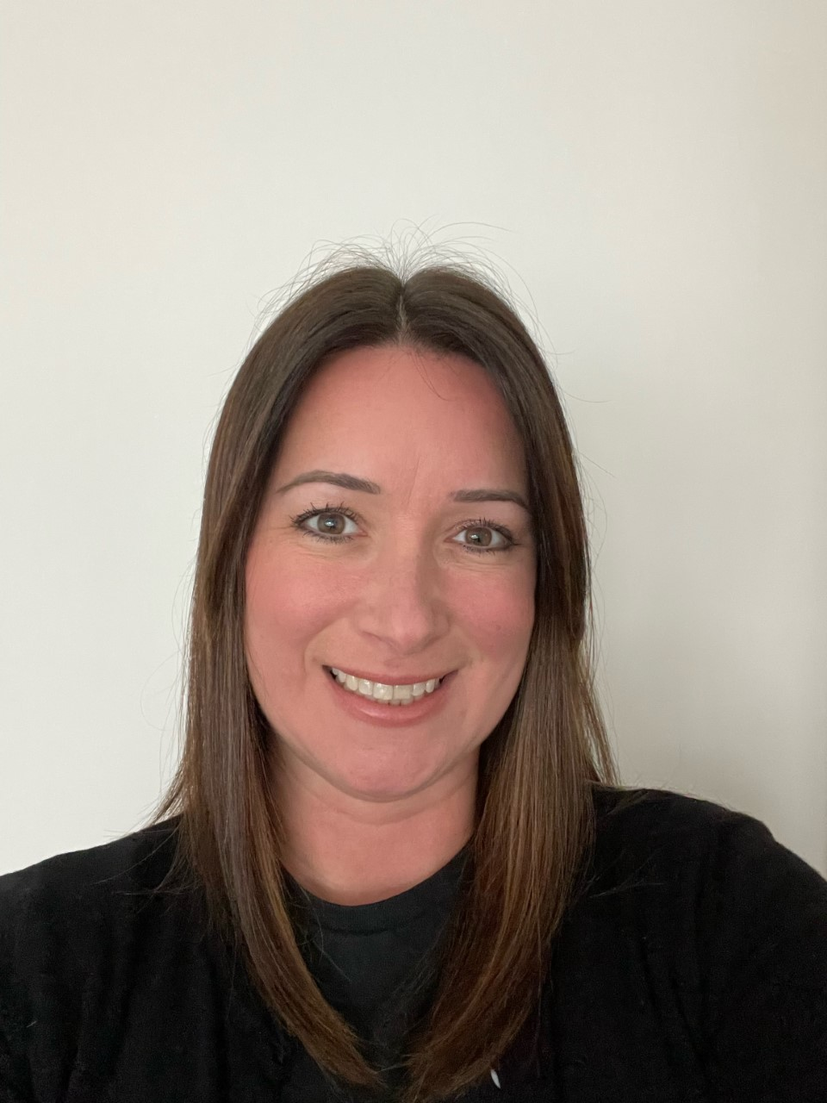
Our Safeguarding Link Governor
Mrs K Parsons
Chair of Governors
Aims
The governing board and school have a responsibility to safeguard and promote the welfare of children, according to the statutory guidance Keeping Children Safe in Education (KCSIE).
The governing board must comply with its duties outlined in part 2 of KCSIE, and make sure that policies and procedures Palmers Cross Primary School are effective and comply with the law.

