Slide 2
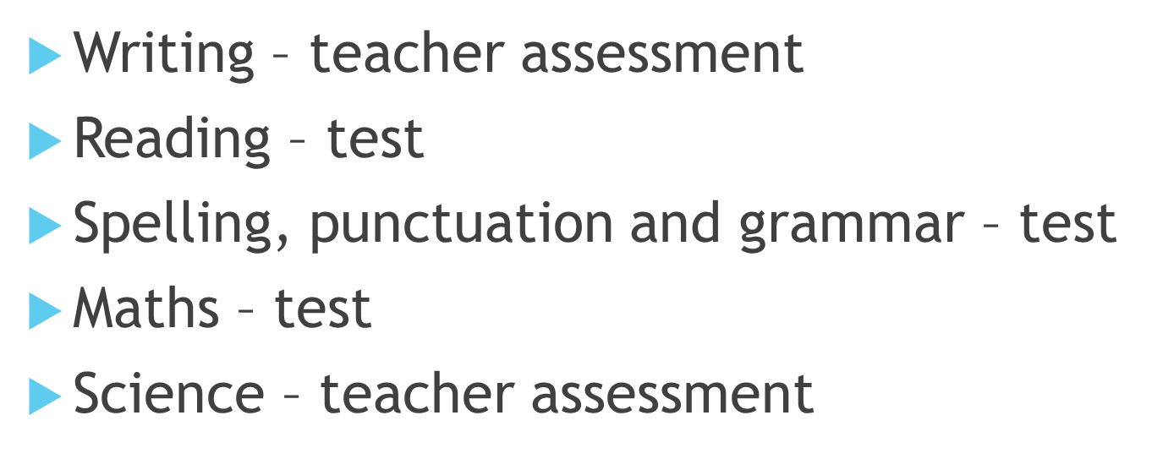

Slide 3
Reading
1 hour test
3 texts to read
Approximately 36 questions to answer

Slide 4
Types of questions

Slide 5
In school
Guided reading sessions
Whole class reading – example questions
Reading in class
Past papers
Reading and maths booster club
Reading cafe

Slide 7
Writing
Teacher assessed throughout the year
Writing expectations to achieve
Termly writing moderation
External moderation
All pupils require a range of writing

Slide 9
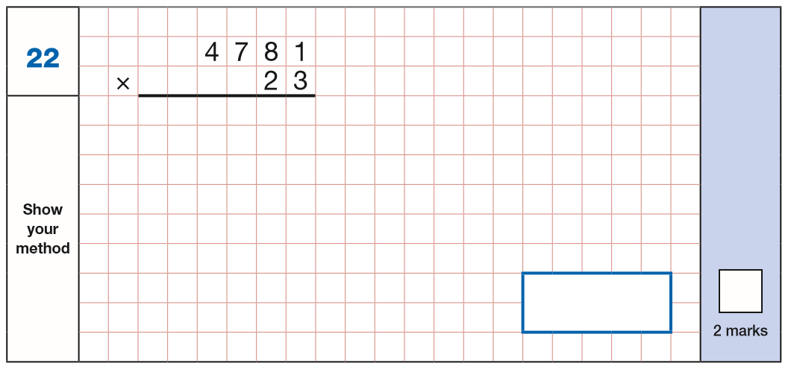
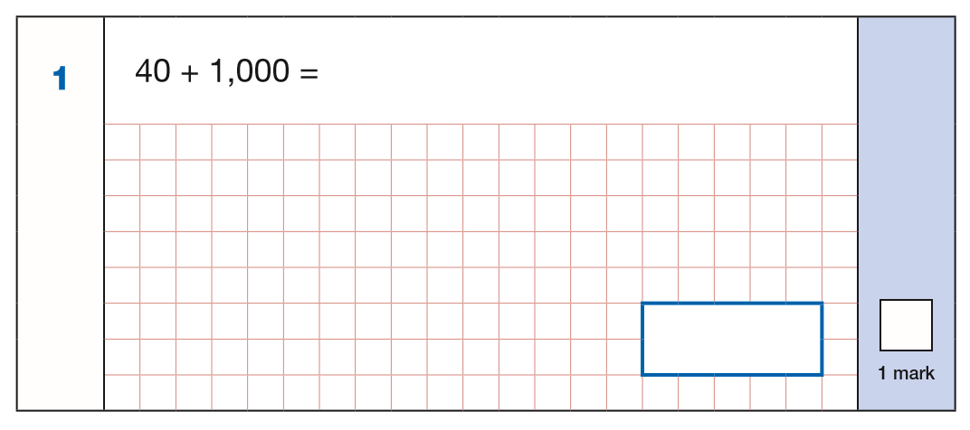
Maths
Arithmetic paper – 30 minutes
Approximately 36 questions

Slide 10
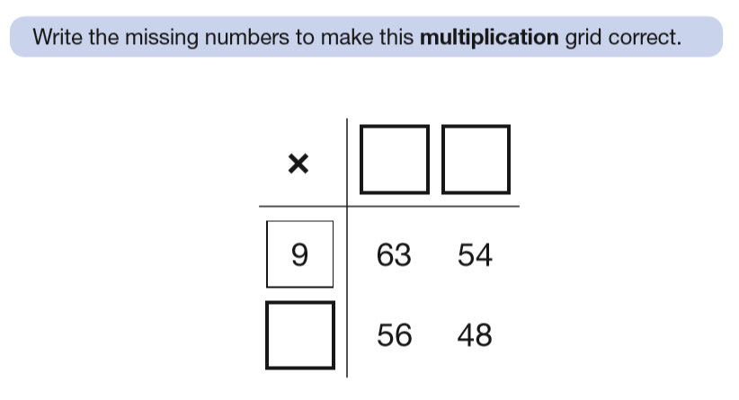
Maths
Paper 2 and 3 are reasoning papers – 40 minutes each

Slide 11
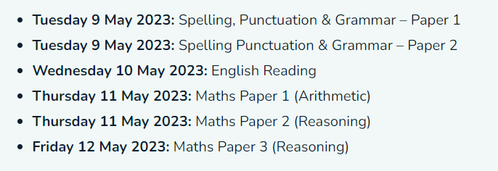
Key stage two example testing week

Slide 12
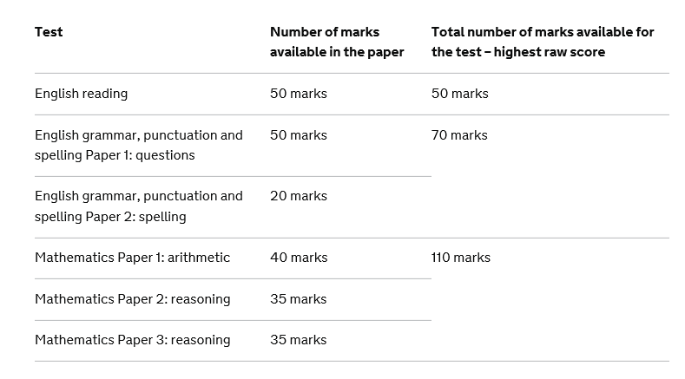

Slide 13
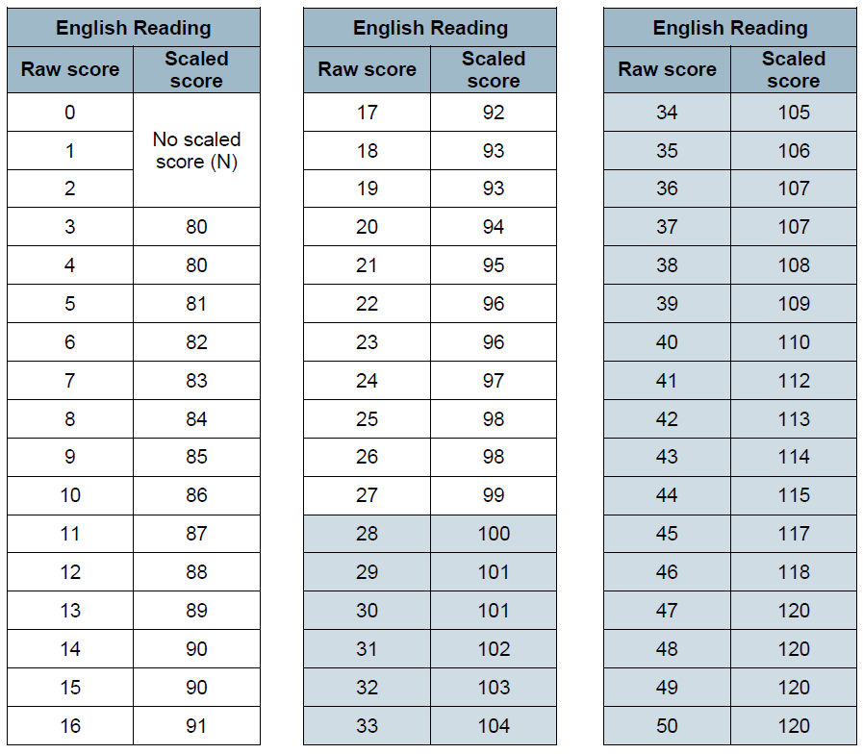
100 – EXS
110 - GDS

