Slide 1
Welcome to Year 6 Parent meeting

Slide 2
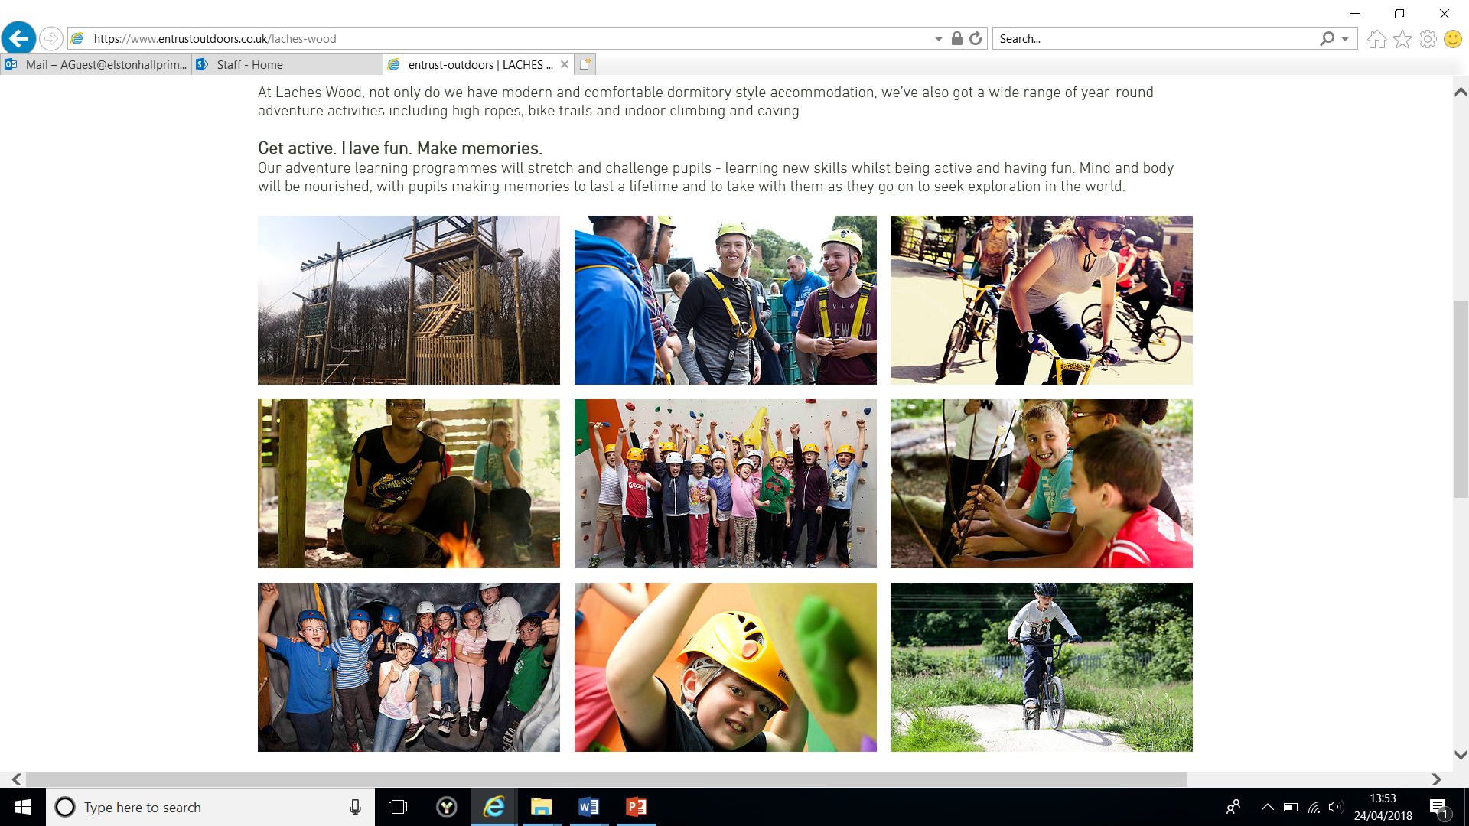
Year 6 Residential 2026
Wednesday 10th June– Friday 12th June
Laches Wood

Slide 3
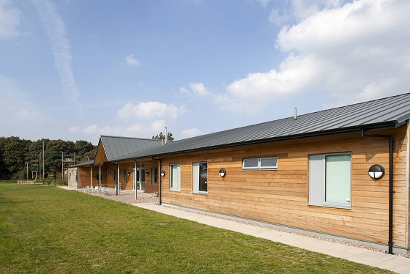
Laches Wood 2026
The Year 6 residential has been booked for June 2026
We are going back to Laches Wood as we have had a fantastic time the past few years and the children made lasting memories with their friends.
Laches Wood is close to school so we will be there for around 10:30am on the Wednesday and won’t need to leave until 2:00pm on the Friday. This means 3 full days of activities and no travel sickness. ☺

Slide 4
So why Laches Wood?
Mixture of natural beauty and adventure.
Modern and comfortable accommodation.
Wide range of activities including high ropes, campfires, canoeing, bike trails and indoor climbing.
Won awards for providing high quality outdoor education.
Encourage pupils to push themselves to try new things and push their limits.
Fantastic team who strive to give us the best experience every time.

Slide 5
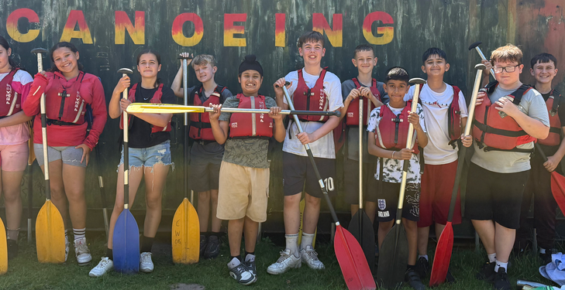
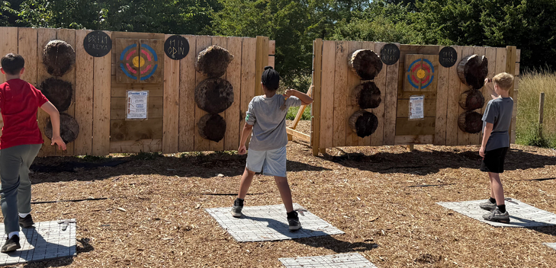
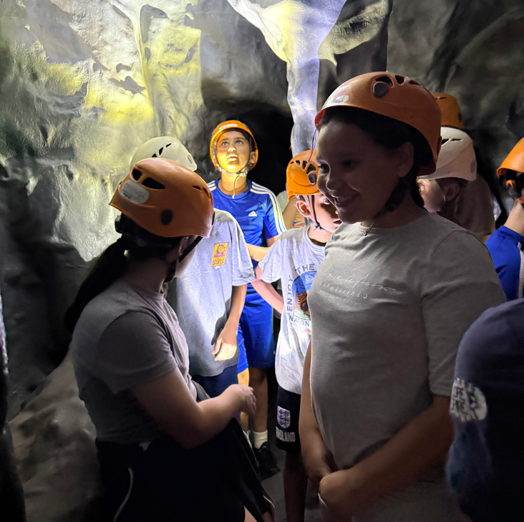
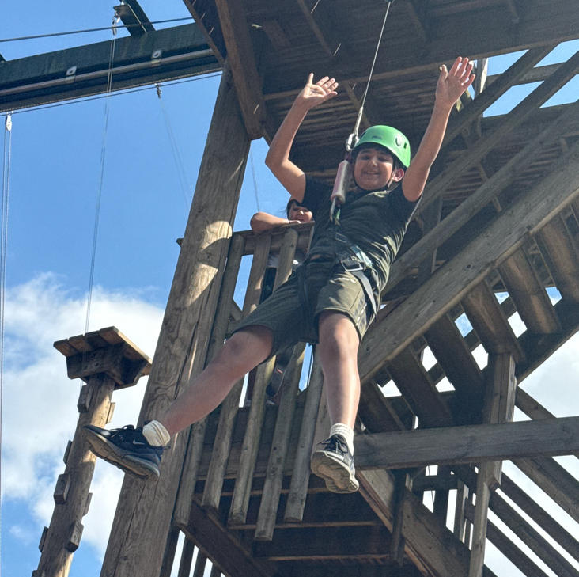
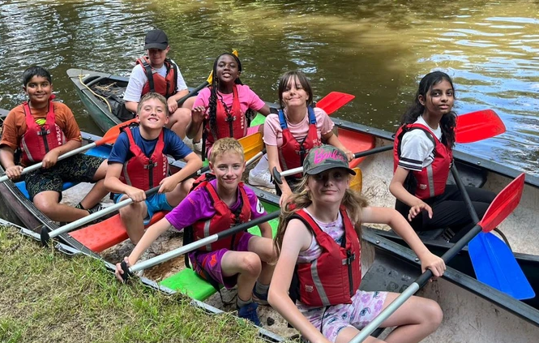
Activities will be just our school, and Year 6 will be split into groups, each one accompanied by a member of our staff as well as an activity leader.
Free time will be spent as a school.

Slide 6
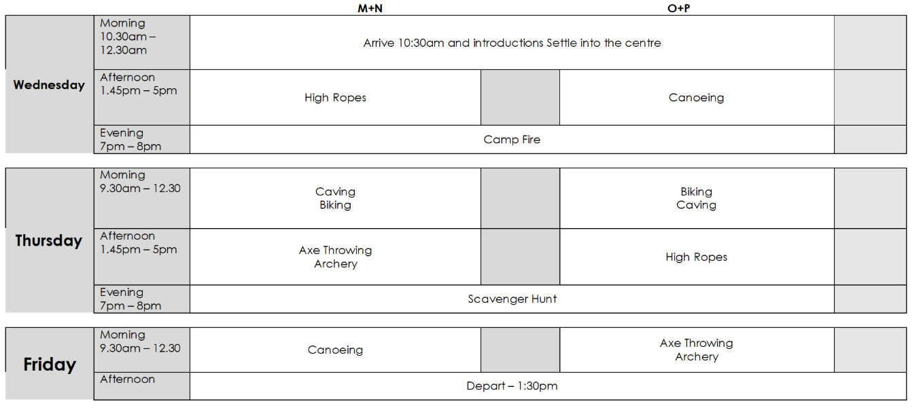
An example itinerary
Children will be split into groups, each group will get the opportunity to do all of the activities.

Slide 7
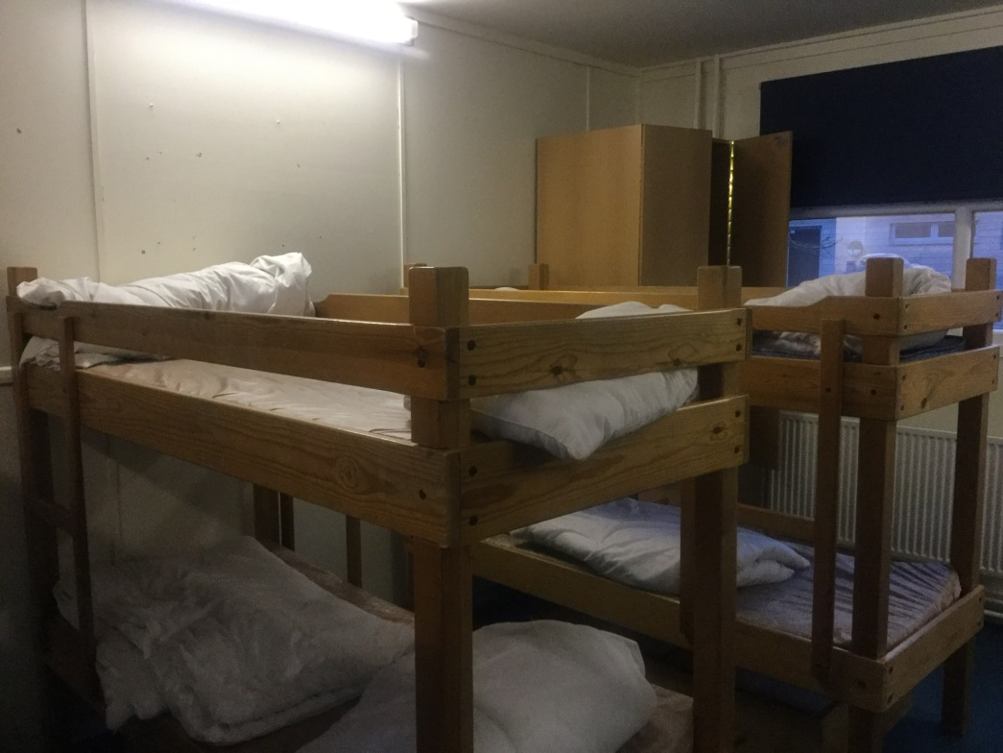
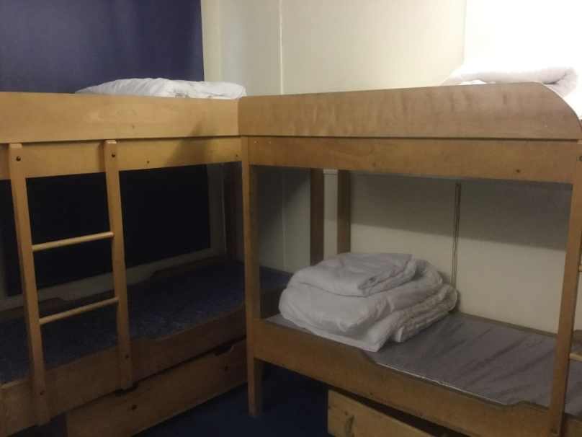
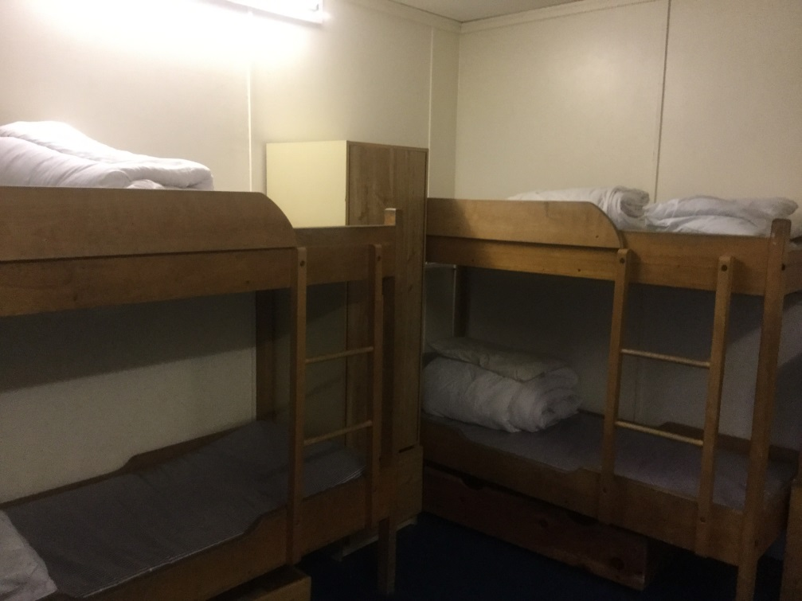
Example bedrooms
All external doors are alarmed in the dormitories. The dormitories will only have Palmers Year 6 children in them. Main doors require a key code to access. Room sizes vary from rooms of 6 to 16.
Girls/boys will sleep separately, as well as having separate shower facilities.
All children will have a cleaning responsibility during their stay.
The children are required to make their own beds. Duvets and pillows are provided, but the children must have their own single duvet cover, sheet and one pillowcase.

Slide 8

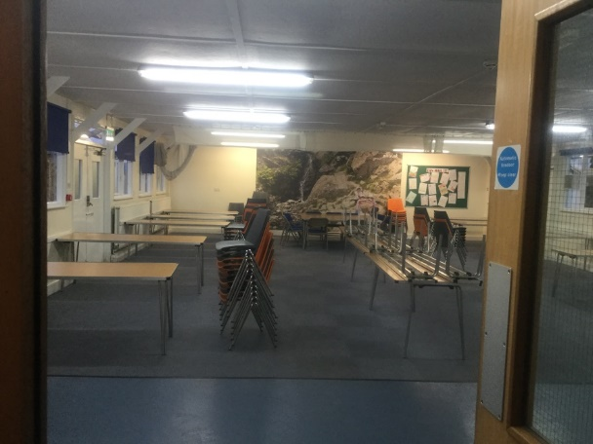
What will the children eat?
Meal choices will be made when we get there, and on each of the following days. Every tap is for drinking water so the children can fill up their water bottle.

Slide 9
How much will it cost?
The total cost of this trip will be around £250, which includes a £60 non-refundable deposit, which should be paid by Friday 7th November to secure your child’s place. We understand this is a slight increase on previous trips with the costs of such places and coaches increasing year on year.
The cost includes: all activities, accommodation and food for the duration of our stay. The remaining balance can be paid in instalments to suit you; weekly, monthly or in a lump sum by Friday 15th May. At this point we will have to give Laches Wood our final numbers and pay them for the trip.
All payments are to be made on Arbor.

Slide 10
Example clothing list
Laches Wood
Residential
Clothing List
Case/holdall
-
small
Waterproof coat
(this is a must!)
Outdoor trainers/
walking boots
Indoor trainers
/pumps
T
-
shirts/long sleeved tops
(layers)
Tracksuit bottoms/
joggers
Warm jumper
/hoodies
Shorts
Changes of underwear/socks
Pyjamas
Towel
Wash bag: toothpaste, toothbrush,
shampoo
,
shower gel,
flannel, comb/hairbrush
Plastic carrier bag (for dirty washing etc)
Plastic bottle for drink (labe
lled)
Book/comic/small game
Pencils/crayons
Torch
Unbreakable mug
Tea towel
A single duvet cover and 1 pillow case
Small back pack to include: (your child will need to carry this each day so it must go on their backs!)
Sunhat/cap
Sun cream
Hand gel
Tissues
Disposable camera (Preferably! Digital cameras will be sent at your risk!)
Plastic carrier bag (to sit on!)
Please note: This is only a suggested clothing list. We do not advise new clothing to be purchased
for this visit! Please ensure that all of your child’s belongings are clearly labelled.

Slide 11
So what next?
Pay your child’s deposit using Arbor pay and hand in consent form.
We will then issue you a receipt and keep track of your payments.
Once numbers are confirmed, itineraries will be finalised and confirmed nearer the time.
Year 6 staff will join the children on the residential and other staff will be confirmed nearer the date.

Slide 12
Any questions?

Slide 13


Slide 14

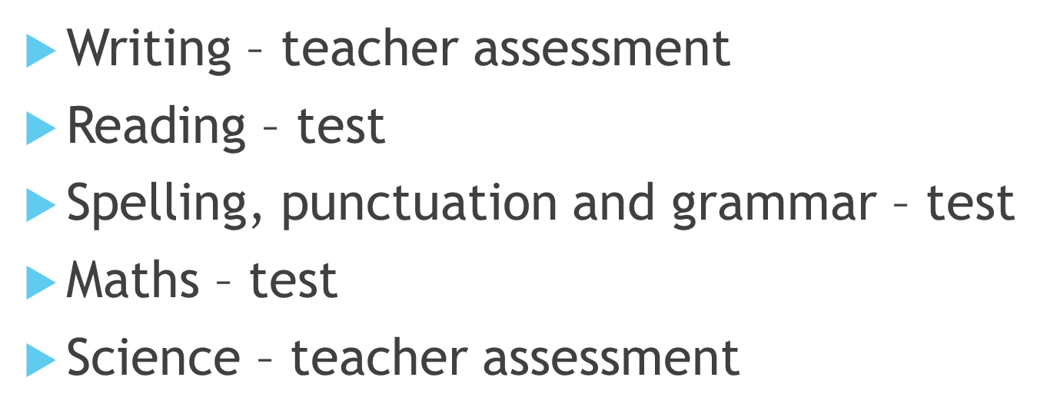

Slide 15

Reading
1 hour test
3 texts to read
Approximately 36 questions to answer

Slide 16
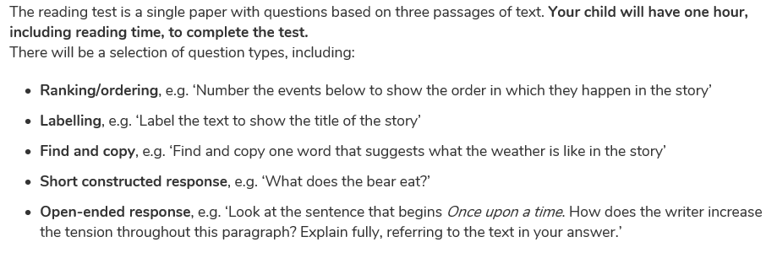
Types of questions

Slide 17

In school
1:1 reading
Whole class reading – example questions
Reading in class
Past papers
Reading and maths booster club

Slide 18
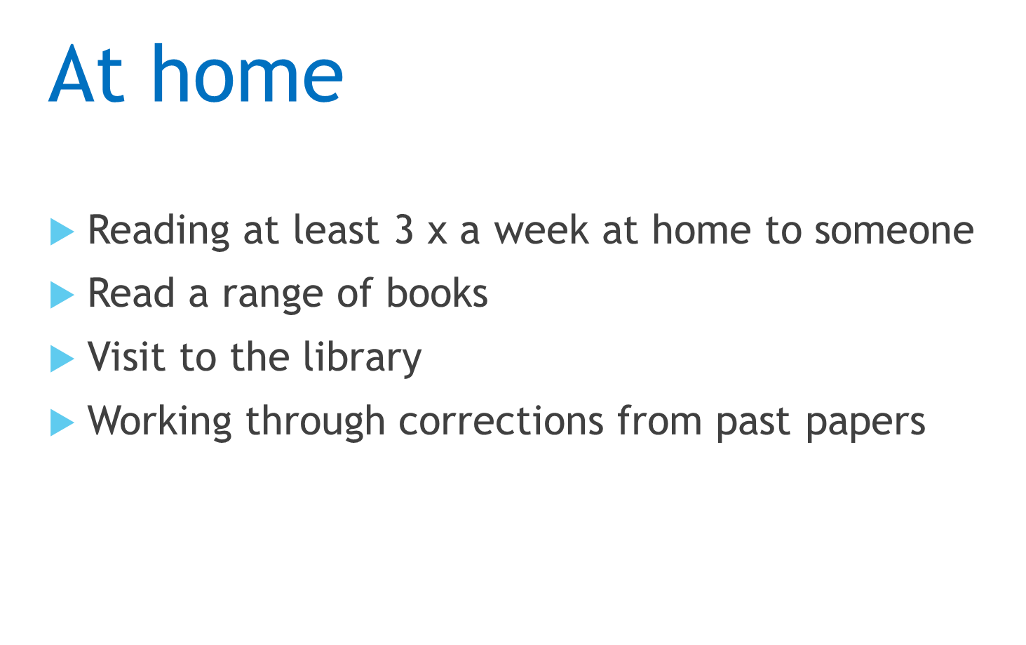

Slide 19
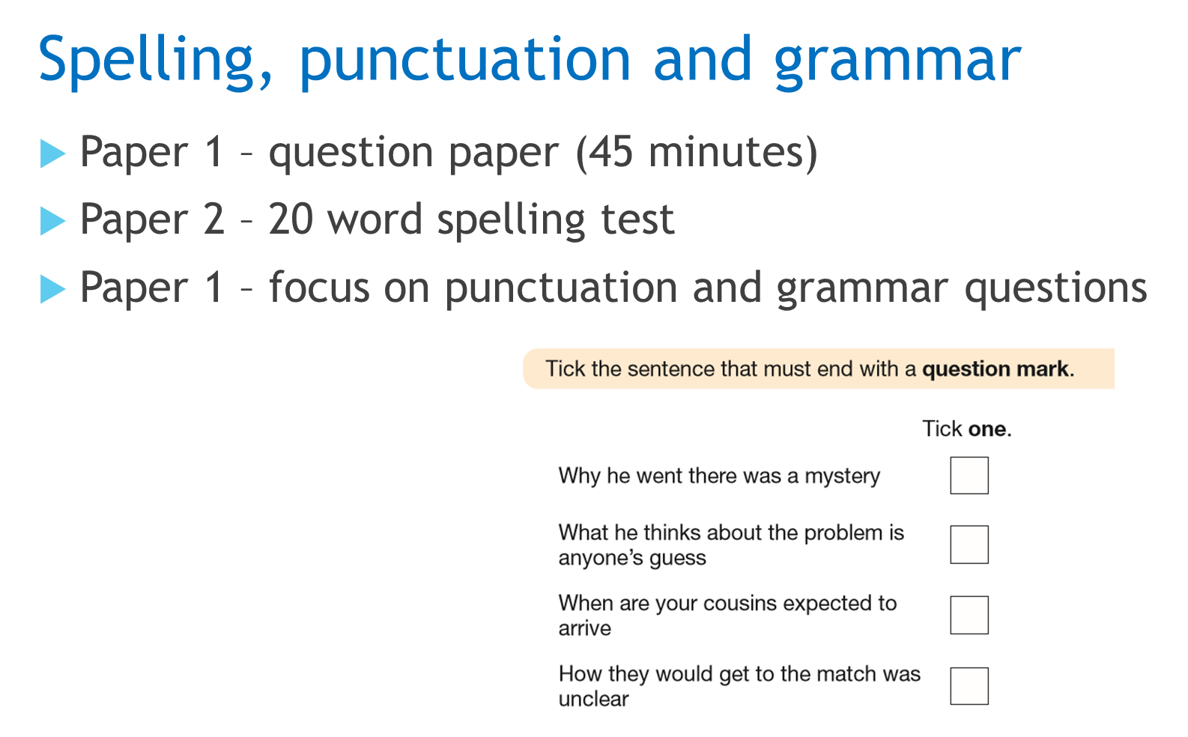

Slide 20
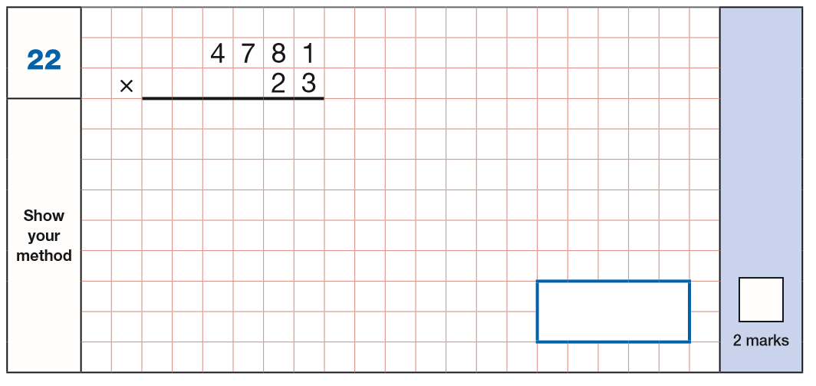
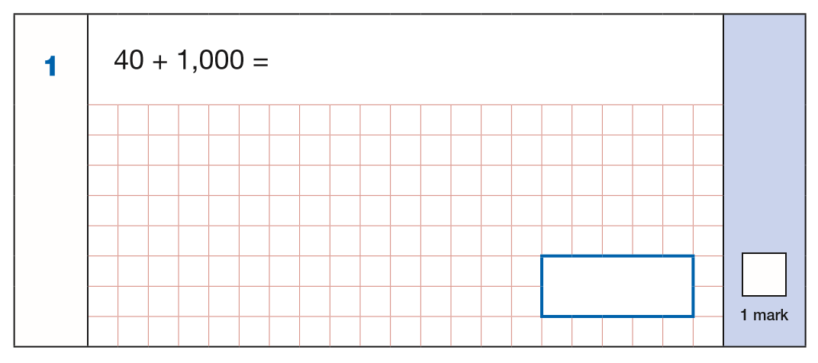
Maths
Arithmetic paper – 30 minutes
Approximately 36 questions

Slide 21
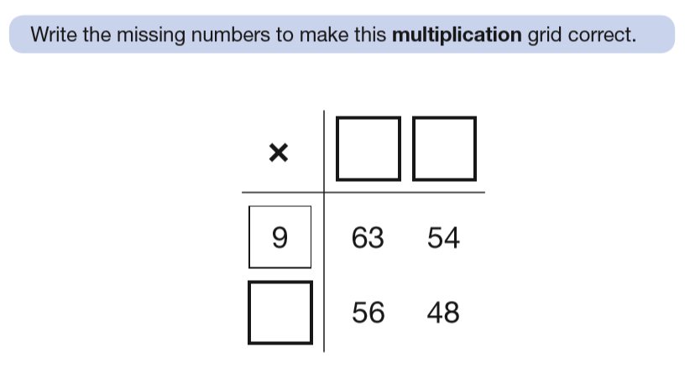
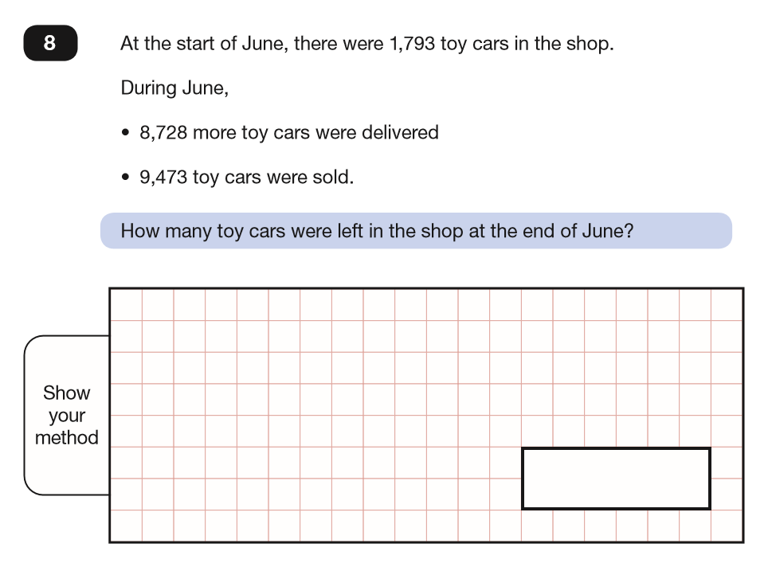
Maths
Paper 2 and 3 are reasoning papers – 40 minutes each

Slide 22

Writing
Teacher assessed throughout the year
Writing expectations to achieve
Termly writing moderation
External moderation
All pupils require a range of writing

Slide 23
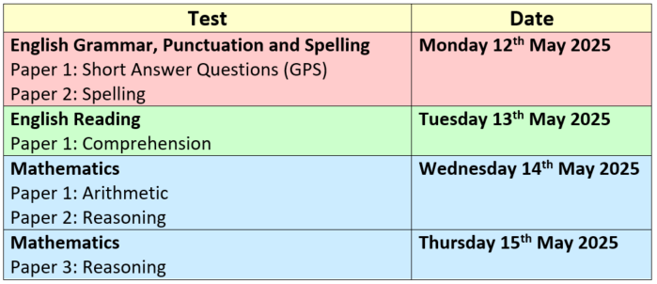
Key stage two example testing week

Slide 24
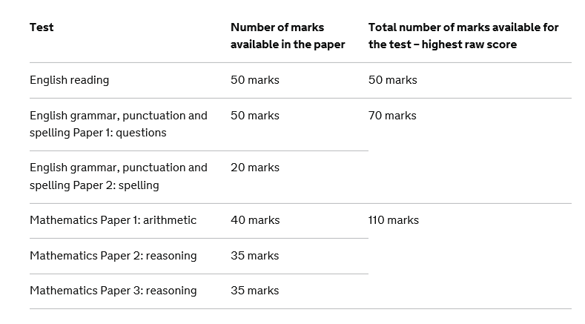

Slide 25
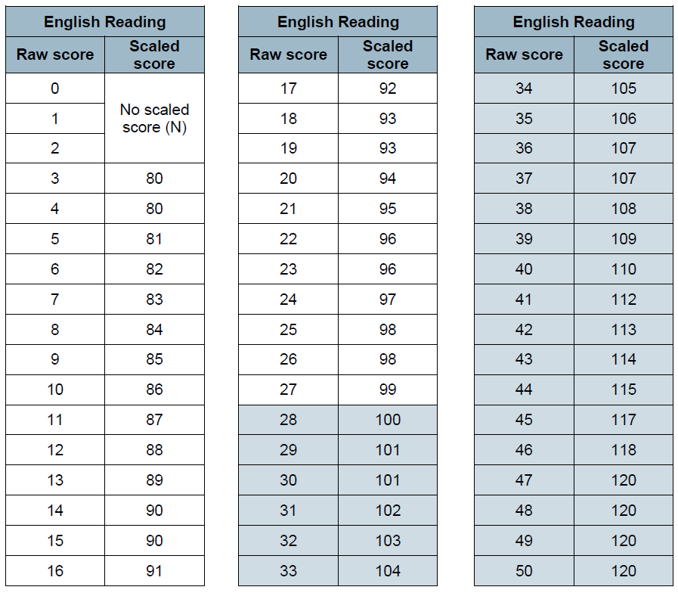
100 – EXS
110 - GDS

Slide 26


Slide 27

https://www.wolverhampton.gov.uk/education-and-schools/school-admissions/apply-secondary-school-places

Slide 28

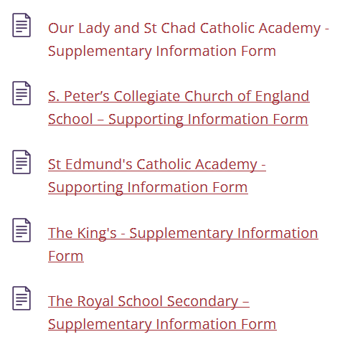


Slide 29
Deadline date
Friday 31st October

